Slide 1
Review
Last week – One Mission: I will make disciples
This week – One Peace: undaunted and unafraid
This week we will receive from Jesus a critical mission briefing. He is asking us to use our time on earth to make disciples but do so fully aware that we are operating in hostile territory.

Slide 2
Background
There are two passages we need to review so that we have the big picture. Daniel 2 and Romans 1.
Neb saw a great statue that provided a glimpse of future empires, Dan interpreted.
Gold, silver, bronze, iron and iron & clay = 4 world empires.

Slide 3
Daniel 2:44-45
In the days of those kings the God of heaven will set up a kingdom which will never be destroyed, and that kingdom will not be left for another people; it will crush and put an end to all these kingdoms, but it will itself endure forever.

Slide 4
Daniel 2:44-45
Inasmuch as you saw that a stone was cut out of the mountain without hands and that it crushed the iron, the bronze, the clay, the silver and the gold, the great God has made known to the king what will take place in the future; so the dream is true and its interpretation is trustworthy (Daniel 2:44–45).

Slide 5
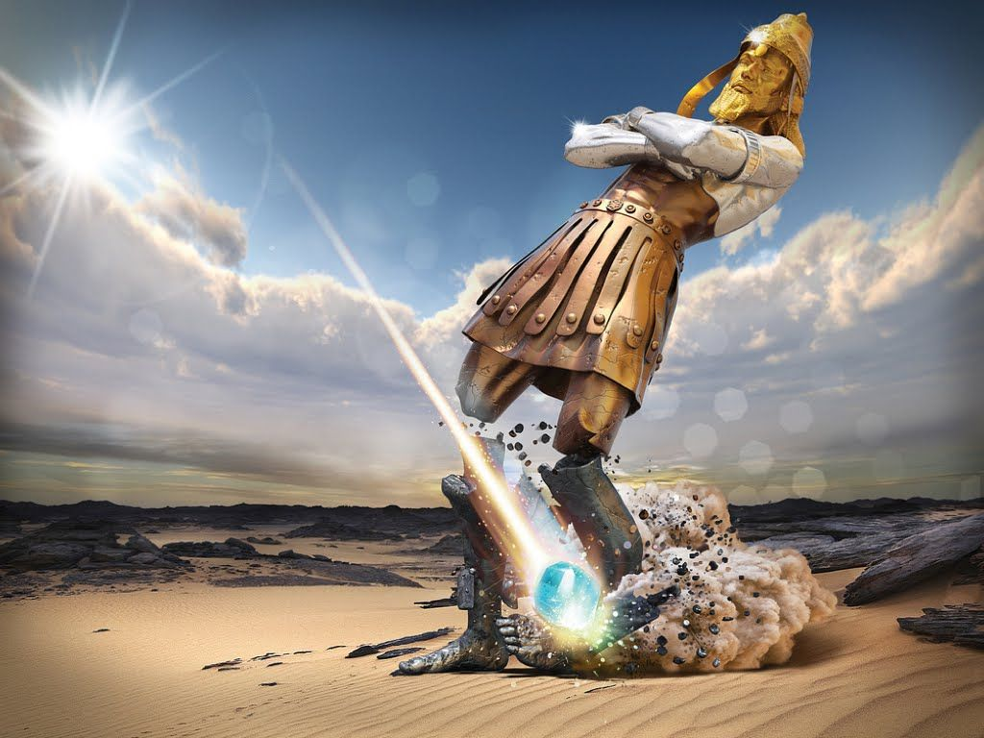
Five (4+) empires
All trace of these will utterly disappear
God will replace them with a non-derivative global kingdom
It will never be destroyed

Slide 6
The empire of man will be crushed when God sets up His kingdom.
The “system” will be “repaired by replacement.”

Slide 7
Our Mission is a Titanic Rescue Mission
The ship cannot be saved.
But we can rescue men, women, and children before the whole thing goes down.
Next Passage Romans 1) describes three stages of peril.

Slide 8
Romans 1:21, 24 – Stage 1
For even though they knew God, they did not honor Him as God or give thanks, but they became futile in their speculations, and their foolish heart was darkened. …Therefore God gave them over in the lusts of their hearts to impurity.
Stage 1: Did not honor God ➔ immorality

Slide 9
Romans 1:26 – stage 2
For they exchanged the truth of God for a lie, and worshiped and served the creature rather than the Creator, who is blessed forever. For this reason God gave them over to degrading passions
Stage 2: Naturalism ➔ perversity

Slide 10
Romans 1:28 – stage 3
And just as they did not see fit to acknowledge God any longer, God gave them over to a depraved mind.
Stage 3: Secularism / Atheism ➔ irrationality
In most cases, “gave over” has a judicial sense – to hand someone over for punishment.

Slide 11
Three Stages of Judgment
Three stages of judgment: Immorality ➔ Perversity ➔ Irrationality
The further a culture is dimmed, the more a Jesus light bulb is going to stand out.
To the degree this is us, Jesus’ warning in today’s passage is vital. So let’s jump in…

Slide 12
Exposition of John 15:18-25
Fact: We are hated
“world” = system of organized society hostile to God, under Satan’s power
John 14:30 - “I will not speak much more with you, for the ruler of the world is coming, and he has nothing in Me” (John 14:30).
The hatred you experience is derivative. You are hated because of Me.
18 – “If the world hates you, you know that it has hated Me before it hated you.”

Slide 13
Exposition of John 15:18-25
Reason we are hated – Change in ID
Friendship with the world is hostility toward God. Whoever wishes to be a friend of the world makes himself an enemy of God (James 4:4).
You cannot choose both. One is dimming, we are brightening.
19 – If you were of the world, the world would love its own; but because you are not of the world, but I chose you out of the world, because of this the world hates you.

Slide 14
Exposition of John 15:18-25
Bottom line: We don’t belong here. Our home is with Jesus, but we are here because we are on mission.
For He rescued us from the domain of darkness, and transferred us to the kingdom of His beloved Son (Colossians 1:13).

Slide 15
Exposition of John 15:18-25
Core Exercise #1: Pain is your friend. Use rejection to focus your ability to live for Jesus’ pleasure alone.
But to me it is a very small thing that I may be examined by you, or by any human court; in fact, I do not even examine myself. For I am conscious of nothing against myself, yet I am not by this acquitted; but the one who examines me is the Lord (1 Corinthians 4:3–4).

Slide 16
Exposition of John 15:18-25
Don’t go into hiding.
We have been sent into the world. This is our mission.
But Jesus wants us to embrace our mission with eyes wide open. “Go; behold, I send you out as lambs in the midst of wolves” (Luke 10:3).
Be a light bulb! Agent of true good to haters!

Slide 17
Exposition of John 15:18-25
Persecution is to be expected for servants of Christ.
Those who respond well to us demonstrate how they would respond to Jesus.
Core Exercise #2: Turn persecution into affirmation.
20 – Remember the word that I said to you, ‘A slave is not greater than his master.’ If they persecuted Me, they will also persecute you; if they kept My word, they will keep yours also.

Slide 18
Exposition of John 15:18-25
Acts 5:40-42: After calling the apostles in, they flogged them and ordered them not to speak in the name of Jesus, and then released them. So they went on their way from the presence of the Council, rejoicing that they had been considered worthy to suffer shame for His name. And every day, in the temple and from house to house, they kept right on teaching and preaching Jesus as the Christ.

Slide 19
Exposition of John 15:18-25
The root cause of this hatred is they do not know God.
They do not have a light bulb on.
There will be some who are less hostile, but the default position is animosity based on ignorance of God.
21 – But all these things they will do to you for My name’s sake, because they do not know the One who sent Me.

Slide 20
Exposition of John 15:18-25
The watchman principle: Ezek 33:1-7
The world has rejected the message Jesus brought. They cannot say, “We didn’t know.”
Hatred of Jesus demonstrates hatred of God.
22-23 – If I had not come and spoken to them, they would not have sin, but now they have no excuse for their sin. He who hates Me hates My Father also.

Slide 21
Exposition of John 15:18-25
Jesus has given no cause for hatred. He has sought to promote the good of the world.
But to embrace His message is to condemn oneself as one in need of saving.
24-25 – If I had not done among them the works which no one else did, they would not have sin; but now they have both seen and hated Me and My Father as well. But they have done this to fulfill the word that is written in their Law, ‘They hated Me without a cause.’

Slide 22
Applications
“Peace I leave with you; My peace I give to you; not as the world gives do I give to you. Do not let your heart be troubled, nor let it be fearful.” (John 14:27).
Don’t allow your heart to become fearful or anxious when you experience rejection for Christ. This is normal!

Slide 23
Applications
Rejoice in the fact that your peace is not dependent on the world’s approval or favorable circumstances.
Yours is a peace that comes from Jesus and grows out of a reconciled relationship with Him. This is bedrock.

Slide 24
Applications
“These things I have spoken to you, so that in Me you may have peace. In the world you have tribulation, but take courage; I have overcome the world” (John 16:33).
The fact that Jesus has successfully defied the world indicates that we already know how things will end. We win! This gives us peace.

Slide 25
Jesus commands us to use our time on earth to make disciples but do so fully aware that we are operating in hostile territory.
“And he who does not take his cross and follow after Me is not worthy of Me” (Matthew 10:38).
When we follow Jesus undaunted by persecution we clearly demonstrate that we belong with Jesus.

Slide 26
I am reasonably confident that following Jesus will become increasingly costly in the days ahead.
Persecution is to be expected, even valued!
Persecution is a grace trigger!

Slide 27
And He has said to me, “My grace is sufficient for you, for power is perfected in weakness.” Most gladly, therefore, I will rather boast about my weaknesses, so that the power of Christ may dwell in me. Therefore I am well content with weaknesses, with insults, with distresses, with persecutions, with difficulties, for Christ’s sake; for when I am weak, then I am strong (2 Corinthians 12:9–10).

Slide 28
For Paul, persecution unlocks “sustaining grace” that allows him to take his devotion to Christ to new heights.
It allows Him to see God working through him in more vivid ways.

Slide 29
Applications
“But I say to you who hear, love your enemies, do good to those who hate you” (Luke 6:27).
Jesus wants us to follow His lead and do good to those who hate us. This is what He did, even in His death.
Priority: So then, while we have opportunity, let us do good to all people, and especially to those who are of the household of the faith (Galatians 6:10).

Slide 30
Applications
Jesus modelled this (in a one way passage):
“You call Me Teacher and Lord; and you are right, for so I am. If I then, the Lord and the Teacher, washed your feet, you also ought to wash one another’s feet. For I gave you an example that you also should do as I did to you” (John 13:13–15).
Not automatic: But if you bite and devour one another, take care that you are not consumed by one another (Galatians 5:15).

